Slide 1
LLM 101 and Model Efficiency, Compression and Distillation
Antreas Antoniou

Slide 2
Overview
LLM 101
  The Transformer, briefly
    Structure and function – i.e. The LEGO blocks
    Interesting traits
    Historical info
  Pre Training algorithms
    Autoregressive algorithms
    Diffusion algorithms
  Fine Tuning Algorithms
    Supervised Fine Tuning
    RL Fine Tuning
Model Efficiency, Compression and Distillation
  Efficiency – A philosophical yet pragmatic overview
  Model compression avenues (tech branches)
    Model pruning
    Quantization
    Distillation and its intriguing properties
  Model algorithmic efficiency avenues
    Faster attention
    Local and dynamic attention
    Faster CUDA kernels, with more memory efficiency
    Faster backpropagation with careful operation fusing
Big Picture Awareness: The LLM training, fine-tuning and deployment cycle
  Pretraining
  Fine tuning
  Make Small and Fast: Algorithmic Efficiency, Compression, Quantization and friends
  Deployment

Slide 3
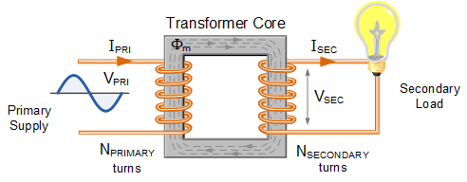
LLM 101: The Transformer
NOT this one …

Slide 4
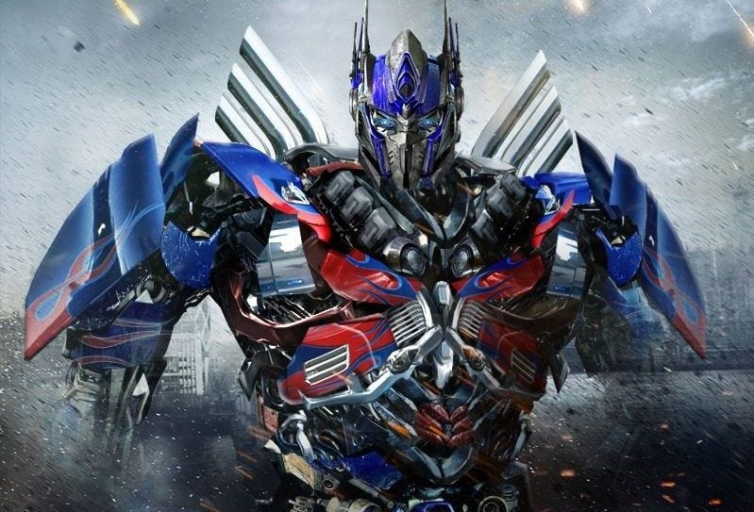
LLM 101: The Transformer
OR this one …

Slide 5
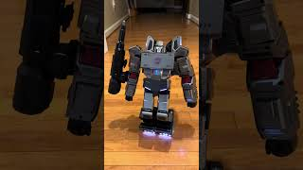
LLM 101: The Transformer
OR even this one …

Slide 6
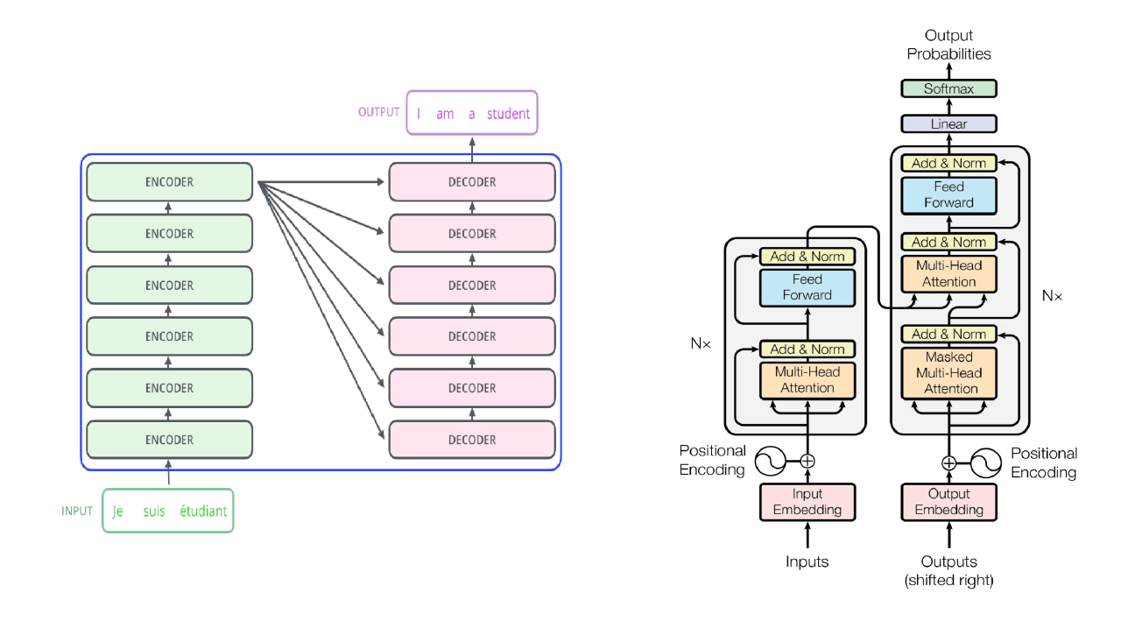
LLM 101: The Transformer

Slide 7
LLM 101: The Transformer

Slide 8
LLM 101: The Transformer Recipe
Chunk your data into tokens, where a token can be an arbitrary yet sensible data unit, e.g. words, subwords, patches, images, 1600x2 samples of audio, DNA pairs, bullets on a slide …
Build a sandwich made of:
  Self attention layers that are the key associative circuits in a transformer
  Activation normalization layers (e.g. Layer Norm) that keep gradients happy
  Skip-connections to maximize information propagation in fprop and bprop
  Very wide fully connected layers after the above to do the heavy computation needed to map the associations of the self-attention layers into meaningful features
Pass the tokenized data into your transformer to receive transformed tokens as outputs

Slide 9
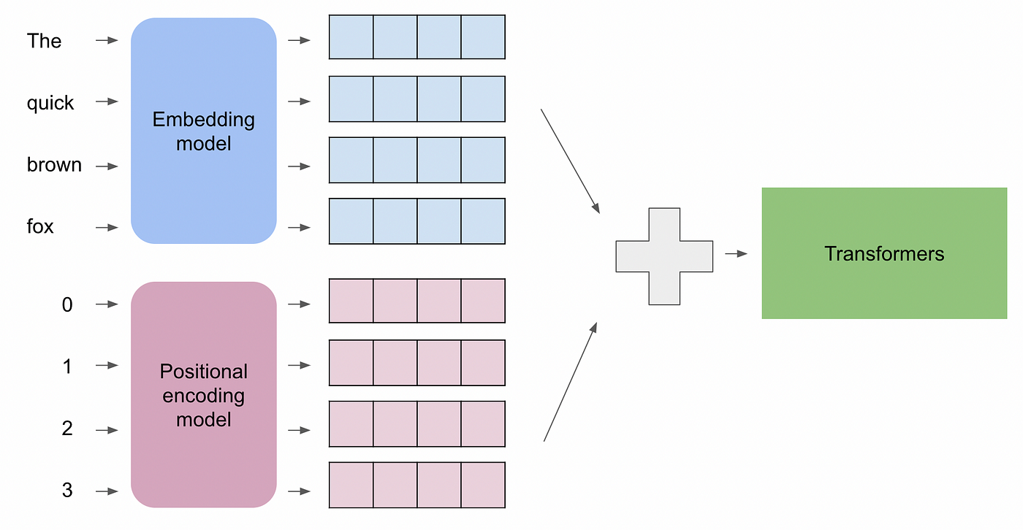
LLM 101: Positional Embeddings
A layer that encodes positional information to our input tokens/vectors. Many types exist, imagination is the limit really, but some of the most successful are:
Sinusoidal/Cosine embeddings
Learnable weights as embeddings
Rotary embeddings using distance and angle from some centroid as means of relating one token to another
Reference: https://medium.com/@hassaanidrees7/understanding-the-role-of-positional-encoding-in-transformers-a9f72dc7f027

Slide 10
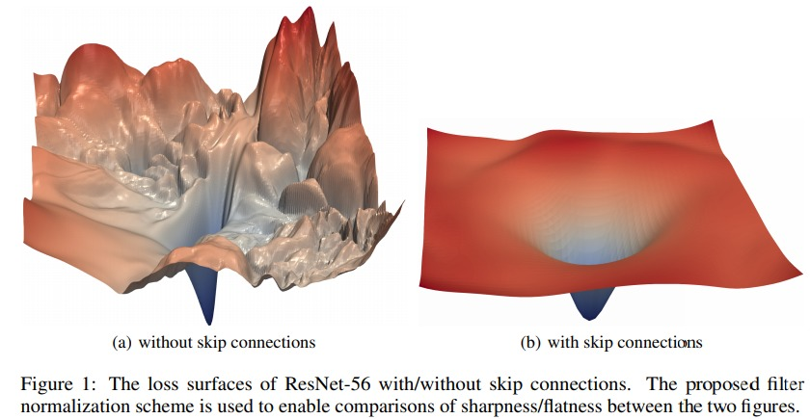
LLM 101: Skip Connections and Layer Normalization
https://arxiv.org/abs/1712.09913

Slide 11
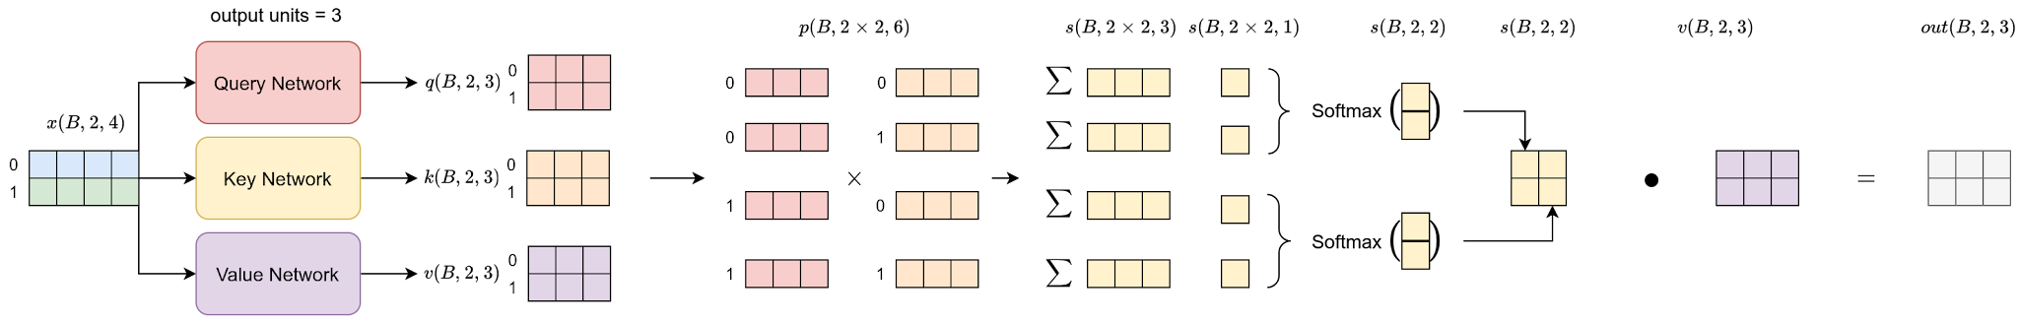
LLM 101: Self-Attention

Slide 12
LLM 101: Intriguing Properties
What makes the Transformer architecture so powerful?
My educated opinion:
Fundamental associative/relativistic pair-wise representation learning more expressive and general than the ‘absolute’ representation learning found in convolutional networks and MLPs.
Areas of attention and shapes of attention are learnable, and not fixed as in MLPs (attend full input) or convolutions (attend single patch each time, never relate to the rest of the patches).
The very functions that are applied on a given token are data-conditional, rather than fixed after training. This enables even further expressiveness in the system, as well as additional mathematical functions to become unlocked, such as x**2.
These make the transformer a very flexible learner, that given large amounts of data will out-generalize MLPs, ConvNets, RNNs and friends, but, at lower data regimes, a non pretrained transformer may fall short compared to ConvNets that have ‘more rigid’ priors that generalize with less data, but are less flexible to change wrt experience.
Hot Take: The Transformer is fundamentally a series of meta-learning networks that have been learned such that given a sequence of tokens, unique weights must be produced that when used to compare tokens with one another can yield information dense outputs that are then passed through the next transformer block that does the same. Learning to learn was underneath it all, all along! And they say meta-learning is not popular nowadays – Antreas Antoniou, PhD in Meta-Learning, 2020

Slide 13
LLM 101: Transformer History Trivia
Produced in Google in 2017
Was adopted by OpenAI in late 2017 and started the GPT family
Has dominated every modality, domain and task ever since
Has terrible name
Has terrible naming of layers, key, value and query? Really?
Has brilliant engineering and intuitions
Manages to make a ‘laundry list’ paper actually work extremely well
Paper: https://arxiv.org/abs/1706.03762
Attention existed in various forms beforehand in: Neural Turing Machines, Memory Networks and Neural Machine Translation by Jointly Learning to Align and Translate
Literal emails between some key folks that came up with the original attention https://x.com/karpathy/status/1864023344435380613?lang=en-GB
Want to know more? Catch me later or email me and we can have a very long coffee conversation.

Slide 14
LLM 101: Training Algorithms
Pretraining:
Autoregressive (Pre)Training (generate tokens one by one)
Diffusion (newer, allows one-shot generation of all output tokens) - https://arxiv.org/abs/2502.09992, https://www.inceptionlabs.ai/news
Fine Tuning:
Supervised fine tuning
RL with human feedback
Other self-supervised RL

Slide 15
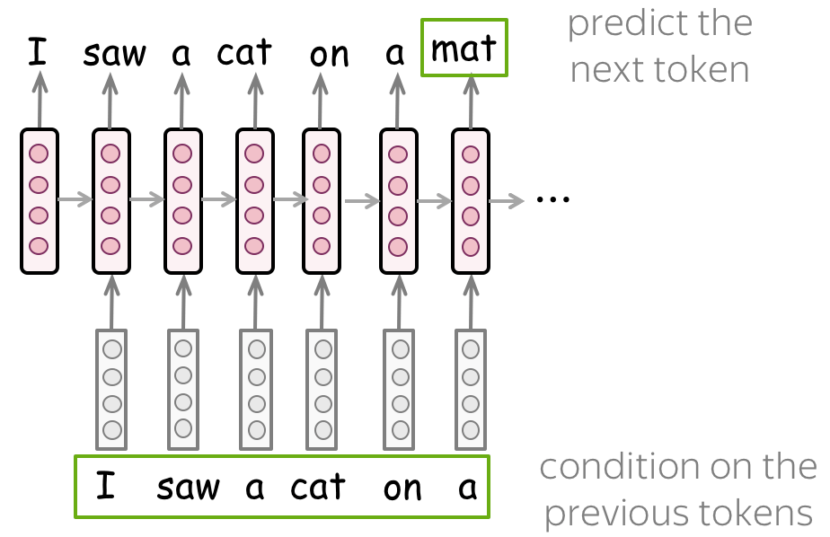
LLM 101: Autoregressive Training

Slide 16
LLM 101: Fine Tuning
Fine-Tuning Large Language Models
1️⃣ What is Fine-Tuning?
Adapting a pre-trained LLM to a specific task, domain, or dataset.
Adjusts model weights to specialize behavior beyond general pretraining.
2️⃣ Prompt Search & Engineering as Knowledge Distillation
Instead of modifying weights, prompt engineering guides the LLM toward better outputs.
Serves as a lightweight alternative to full fine-tuning.
Example: Chain-of-thought prompting improves reasoning without retraining.
3️⃣ Supervised Fine-Tuning (SFT) Methods
Use standard supervised SGD to tune model for a given task such as instruction following

Slide 17
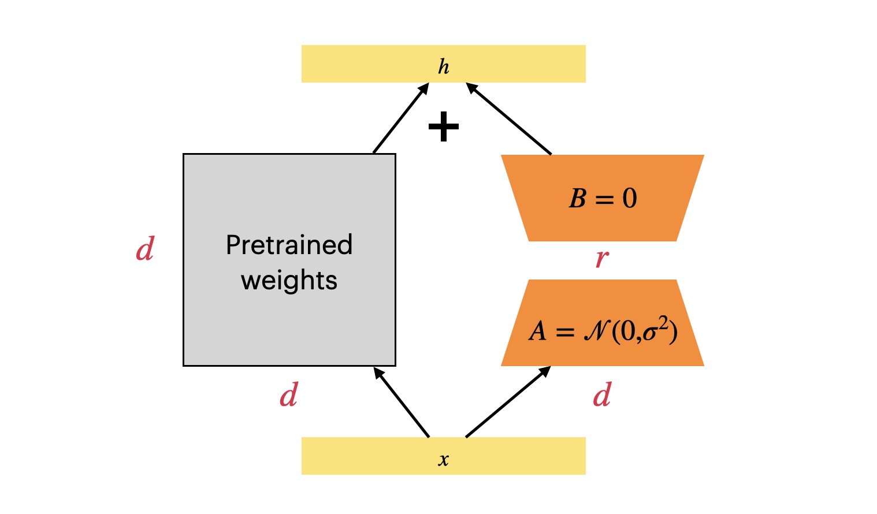
LLM 101: PEFT vs FFT
1️⃣ Full Fine-Tuning (FFT)
✔ Fine-tunes all model parameters on a specific dataset.
✔ Best for deep domain shifts (e.g., medical, legal, or code-specific LLMs).
✔ Often outperforms PEFT in my experience, especially when large compute is available.
✖ Requires high GPU memory and significant training time.
2️⃣ Parameter-Efficient Fine-Tuning (PEFT)
✔ Fine-tunes only a small subset of parameters (e.g., LoRA, Adapters).
✔ Reduces compute cost, making LLM tuning feasible on fewer GPUs.
✔ Essential when GPU resources are limited (e.g., single or low-memory GPUs).
✖ Can be less efficient when running on 4-8x high-memory GPUs, as full fine-tuning may be preferable.
✖ May lead to slight performance drop compared to FFT for some tasks.
LORA - https://arxiv.org/abs/2106.09685

Slide 18
On training the LLM beast
There are generally speaking three directions for training LLMs efficiently
Single GPU training
Multi-GPU training using Data-Parallel (does not work for models that need more than 1 GPU worth of memory to fprop and bprop)
FSDP

Slide 19
On FSDP
Fully Sharded Data Parallelism (FSDP)
1️⃣ What is FSDP?
A memory-efficient distributed training technique for large models.
Shards model parameters, gradients, and optimizer states across GPUs.
Reduces memory usage while enabling larger batch sizes and training stability.
2️⃣ FSDP Modes & Settings
Full Parameter Sharding: Shards weights, gradients, and optimizer states across GPUs.
Mixed Precision (bf16/fp16): Reduces memory usage while maintaining numerical stability.
Activation Checkpointing: Saves GPU memory by recomputing activations during backpropagation.
Auto Wrapping: Automatically applies sharding to transformer blocks instead of manually specifying layers.
3️⃣ Optimal Hyperparameters Depend On Hardware, Model, Task and Data

Slide 20
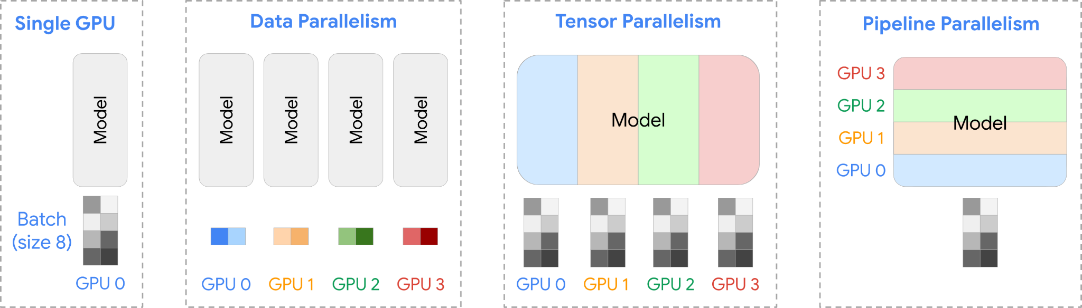
On FSDP

Slide 21

Model Efficiency, Compression and Distillation

Slide 22
Efficiency
Computational Efficiency:
  Efficient architectures
  Efficient code
  Efficient hardware
Idea Efficiency:
  Simplicity
  Ease of thought and composition
  Cognitive complexity
  Scalability
Research Efficiency:
  Ease of access and use
  Ease of modification
  Ease of evaluation

Slide 23
Model Compression Branches
Model Pruning: Remove lower importance connections to reduce model size – sparsity becomes key
Quantization: Reduce numerical precision of weights and activations.
Distillation: Transfer knowledge from a large model to a smaller one.

Slide 24
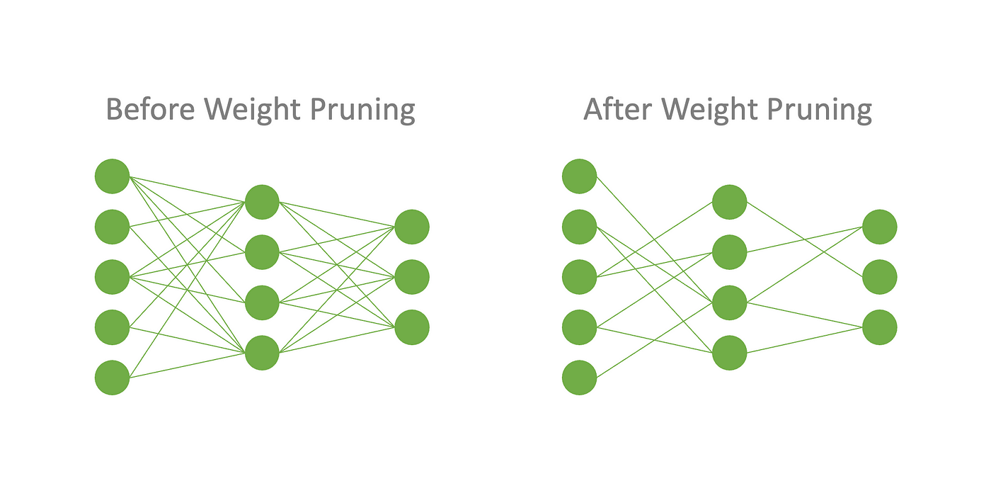
Model Pruning
A technique that reduces weights and activations in a model. Generally requires:
A criterion for pruning (value of gradient, weight or other)
Scale of pruning (weight, filter etc)
Halting criterion
✅ Pros
✔ Faster inference (lower latency)
✔ Smaller model size (memory-efficient)
✔ Lower energy consumption (better sustainability)
✔ Improves generalization (reduces overfitting)
✔ Works with other compression techniques
❌ Cons
✖ Accuracy loss (if over-pruned)
✖ Requires retraining (fine-tuning needed)
✖ Sparse models may not speed up (hardware inefficiencies)
✖ Hard to automate (finding the right pruning ratio)
✖ Risk of catastrophic forgetting (bad for continual learning)

Slide 25
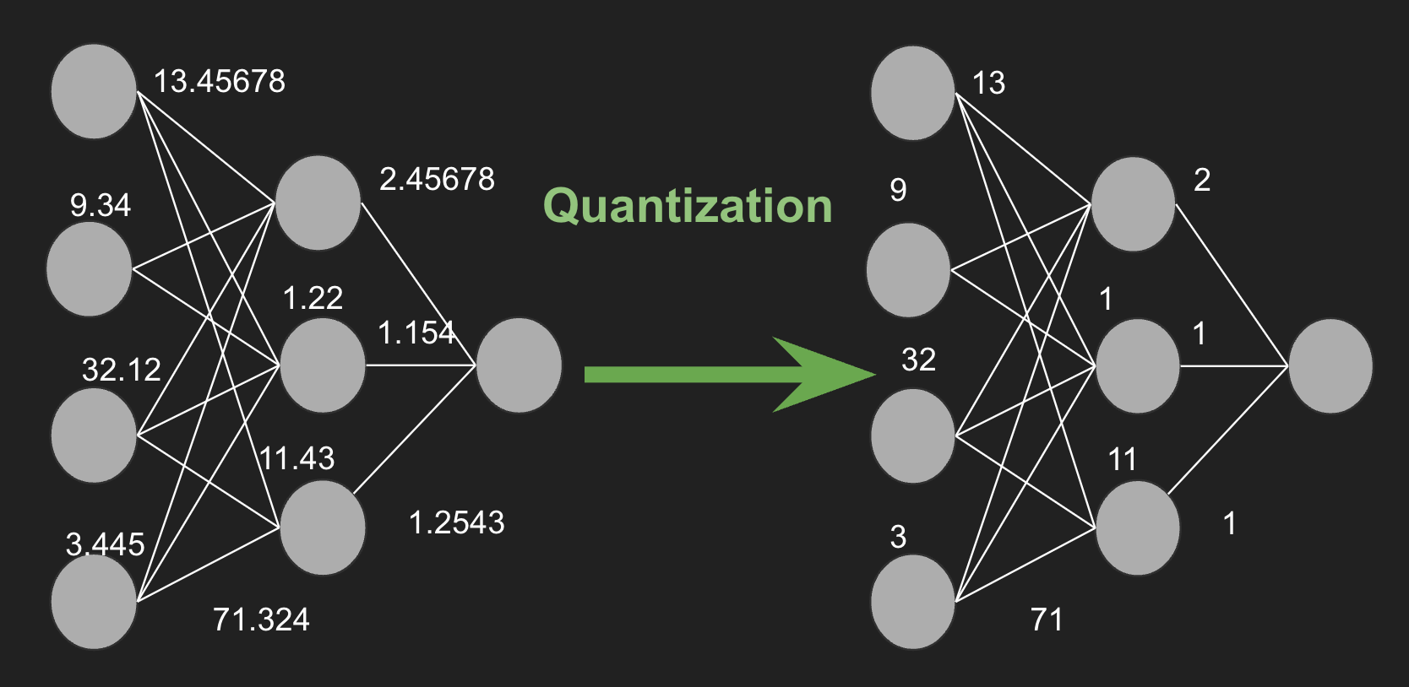
Model Quantization
Popular Quantization Schemes
📌 Post-Training Quantization (PTQ) – Fast but higher accuracy loss
📌 Quantization-Aware Training (QAT) – Better accuracy, more complex
📌 Dynamic vs. Static Quantization – Runtime vs. precomputed activations
📌 4-bit, 8-bit, and Grouped Quantization – Common for LLMs
✅ Pros
✔ Smaller models (lower memory footprint)
✔ Faster inference (CPU/GPU/TPU acceleration)
✔ Lower power consumption (great for mobile/IoT)
✔ Compatible with hardware accelerators (INT8, FP16, etc.)
❌ Cons
✖ Accuracy drop (especially in aggressive quantization)
✖ Numerical instability (rounding errors, precision loss)
✖ Hardware-dependent benefits (not all platforms support it)
✖ Hard to quantify post hoc (if not trained with quantization in mind)
🛠 Top Quantization Libraries
🚀 bitsandbytes (Hugging Face) – 4-bit/8-bit quantization
🚀 GPTQ – Optimized 4-bit quantization for LLaMA, GPT
🚀 TensorRT-LLM – Best for NVIDIA GPUs

Slide 26
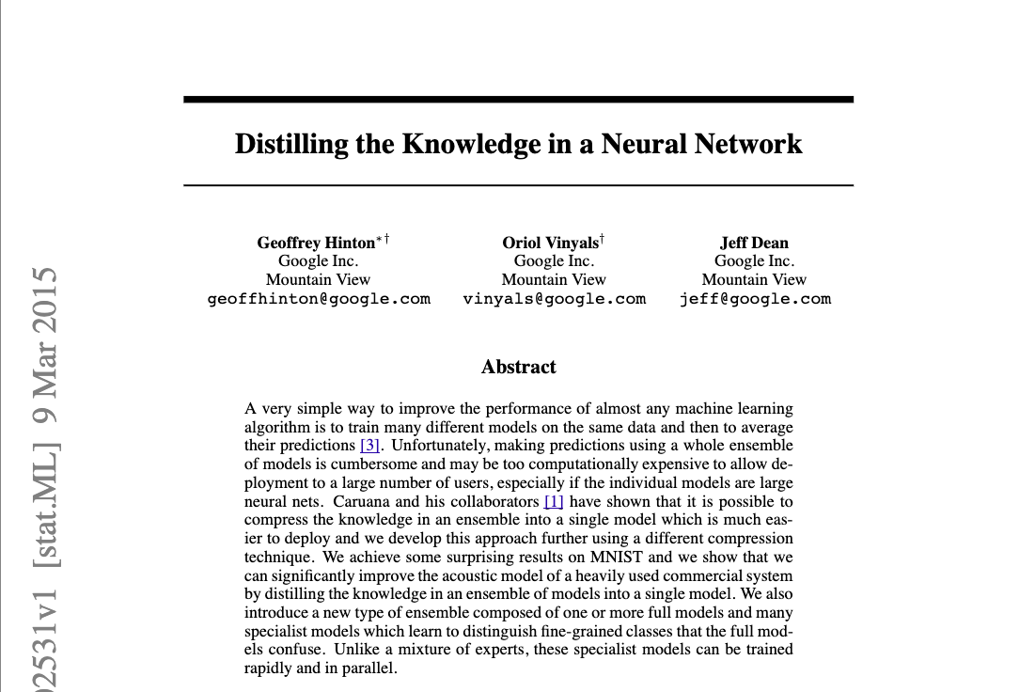
Distillation - https://arxiv.org/abs/1503.02531

Slide 27
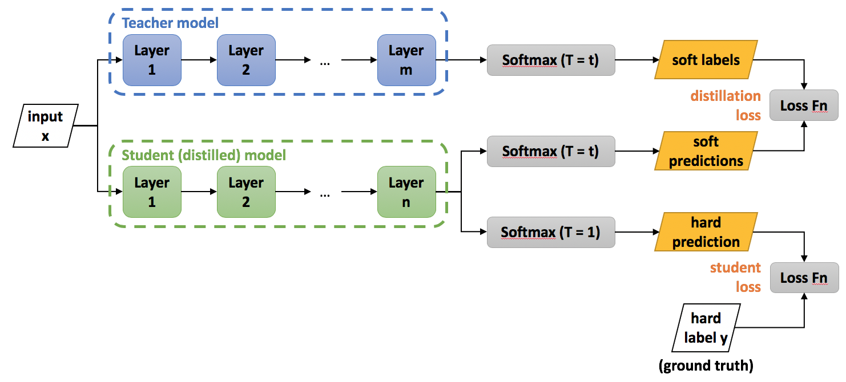
Distillation: High Level Idea

Slide 28
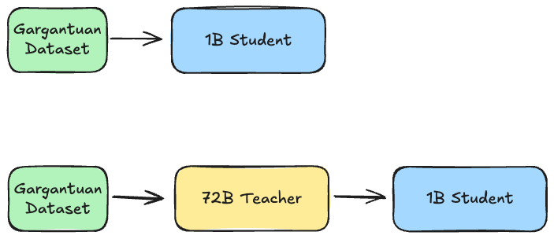
Distillation: A conundrum
Which student performs best?

Slide 29

But why?
Nobody really knows yet.
However, some of my own views:
Lottery Ticket Hypothesis https://arxiv.org/abs/1803.03635 -> Within a large NN there exists a small NN that performs as well as the big one, but to find it you MUST train the big one first.
Distillation may in fact be distilling that small subnetwork from the larger teacher into the smaller student. A form of adaptive pruning if you will that adjusts based on the student size.
Since large networks generally generalize better than smaller ones, finding that subnet can yield large model performance in smaller footprint.
A very good intuition is:
Think of as the larger model as the larger parallel search for a good solution, the more parameters and paths, the more likely a path found will be closer to the global best.
Once learned, that path can be compactly extracted into a smaller model.

Slide 30
Distillation Types
Knowledge Distillation (KD)
Concept
A smaller student model learns from a larger teacher model using soft labels.
Soft targets contain probability distributions, making training more informative.
Algorithm
Train a large teacher model on a dataset.
Extract soft probabilities (logits) from the teacher using a temperature scaling factor.
Train the student model using a combined loss function that balances standard cross-entropy loss and the divergence between teacher and student logits.

Slide 31
Distillation Types
Progressive Distillation
Concept
Instead of distilling a large model directly into a small one, intermediate-sized models are used as stepping stones.
Reduces performance degradation while maintaining knowledge transfer.
Algorithm
Train a large teacher model.
Train an intermediate student model using knowledge distillation.
Use the intermediate student as a new teacher and distill into a smaller model.
Repeat the process until the desired model size is reached.

Slide 32
Distillation Types
Task-Specific Distillation or Distillation as a Synthetic Data Generator
Concept
Instead of general-purpose compression, the student model is trained to perform well on a specific task or domain (e.g., medical, legal, programming).
Retains high accuracy while significantly reducing model size.
Algorithm
Train a general teacher model on a large dataset.
Fine-tune the teacher model on a domain-specific task (e.g., medical text classification).
Distill the task-optimized teacher into a smaller student model.
Use task-specific loss functions (e.g., ranking loss for retrieval models) to refine performance

Slide 33
Distillation Types
Layer-wise Distillation
Concept
Instead of only distilling final outputs, the student model learns from intermediate hidden layer representations of the teacher.
Helps preserve semantic knowledge and improves generalization.
Algorithm
Train a large teacher model.
Extract hidden representations from multiple layers of the teacher.
Train the student to minimize the difference between its own intermediate representations and those of the teacher.
Weight different layers based on importance to optimize knowledge transfer.

Slide 34
Distillation: How far can we go?
Available Now - Low Hanging Fruit
  Progressive distillation and similar techniques may offer a way to produce a multi-scale variant of a given model.
  Such variants may be dynamically chosen given task and cost constraints.
  Better distillation can unlock LLMs and LMMs for local single GPUs of even the largest models out there.
Work exists but more research needed - Medium Hanging Fruit
  Is there a way to reduce the computational cost of distillation itself? Are there any shortcuts we can take, or any dynamic ways to reduce scale when a threshold is hit?
  What are the effects of multi-teacher into single student distillation?
  What happens when we distill into the same scale student? Is there a way to make distillation improve generalization? Synthetic data generation as distillation seems to point towards that.
Blue skies - High Hanging Fruit
  The lottery ticket hypothesis and distillation seem to point towards the fact that many learned connections will end up being redundant in the grand scheme of things.
  Can we intelligently detect this at training time and compress as we train?
  If we cannot skip pretraining the larger teacher, is it possible to know when a certain ‘depth’ is ready for distillation so we can distill at that depth and then use the student as part of the teacher to learn the deeper layers?

Slide 35
Algorithmic Efficiency
Model Algorithmic Efficiency Avenues
1. Faster Attention Mechanisms
Linear attention, flash attention, and sparse attention reduce computational complexity.
Improves scalability for large sequence lengths.
2. Local and Dynamic Attention
Focuses only on relevant tokens instead of full attention maps.
Reduces memory and computational overhead.
3. Optimized CUDA Kernels
Custom low-level CUDA implementations enhance speed and memory efficiency.
Reduces redundant memory accesses and improves tensor operations.
4. Faster Backpropagation with Operation Fusion
Combines multiple small tensor operations into larger, more efficient ones.
Reduces memory transfers and improves GPU utilization.

Slide 36
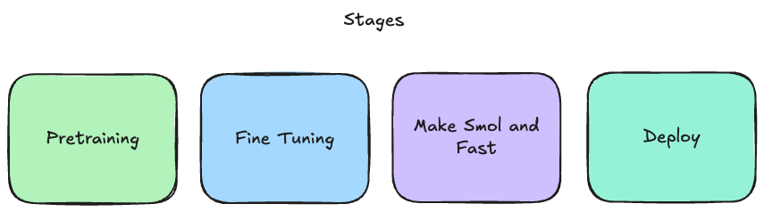
Big Picture: High Level Stages

Slide 37
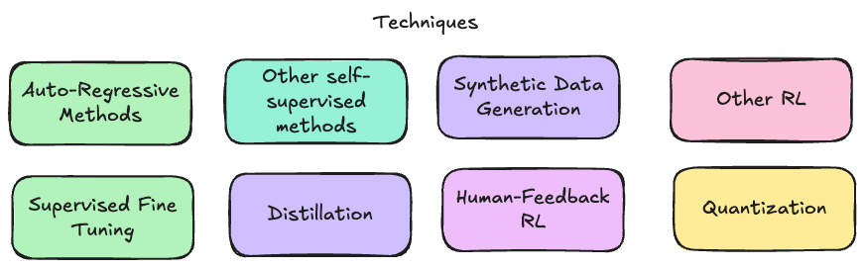
Big Picture: Underlying Technique Components
Note: Colours indicate degree of relatedness of one technique to the other, IT DOES NOT relate to the colours in previous slide. When searching for and studying methods replace ‘other’ with ‘LLM’ for better results.

Slide 38
Extra Time? Extra fun!
Awesome LLM training, fine tuning, compression and deployment tooling.
Deeper questions in Distillation and Fine Tuning?
Go treasure hunting for relevant huggingface spaces?

Slide 39
Treasure Trove of Resources
Minimal, but thorough codebase for training and fine tuning modern LLMs – https://github.com/axolotl-ai-cloud/axolotl
Largest datasets, models, and app repository in the world – https://huggingface.co look at ‘spaces’ for interesting app demos
Great places to use LLMs with good interface
  https://chatgpt.com
  https://claude.ai
  https://groq.com – uses new hardware architecture made for LLMs
  https://grok.com
  https://www.perplexity.ai – search + LLM summary

